Slide 1





Shri Vishnu Engineering College For Women
(Autonomous)
Department Of Computer Science Engineering
Real-Time Cyber Threat Detection on Telegram
Presented By:
22B01A0573
22B01A0586
22B01A05B3
23B05A0511
Guided By:
Mr. P.Naga Raju

Slide 2

ABSTRACT
This project focuses on developing a web-based cybersecurity solution to detect and mitigate suspicious activities on Telegram. As cybercriminals increasingly exploit platforms like Telegram to spread scams, phishing links, and fraudulent schemes, there is a growing need for automated tools that can enhance user safety. The solution will continuously monitor messages in real-time to identify potential threats, such as fake money offers, malicious links, and impersonation scams. Detected suspicious messages will be logged in a secure database, and a Flask-based web dashboard will allow users to view alerts and message history. To ensure timely action, the solution will also provide real-time notifications through email or Telegram. By offering an automated way to detect cyber threats, this project aims to contribute to enhancing online security and reducing the impact of digital fraud

Slide 3
INTRODUCTION
In today’s digital world, communication platforms like Telegram are widely used for personal, professional, and community interactions. However, these platforms have also become attractive targets for cybercriminals, who exploit their openness to spread scams, phishing links, and fraudulent schemes.
This project, "Real-Time Cyber Threat Detection on Telegram", aims to enhance cybersecurity by developing a web-based solution that monitors Telegram messages, detects potential cyber threats such as scams and phishing, and provides real-time alerts to users. By automating threat detection and offering proactive alerts, this solution addresses the increasing risks posed by online fraud and malicious activities on communication platforms.

Slide 4
TECHNOLOGIES
1. Programming Language : Python
2. Libraries:
- python-telegram-bot
- Scikit-learn
- Flask
- smtplib
3. Database : MongoDB

Slide 5
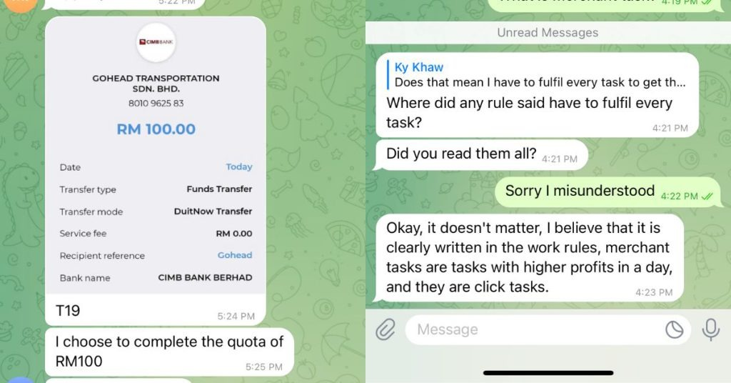
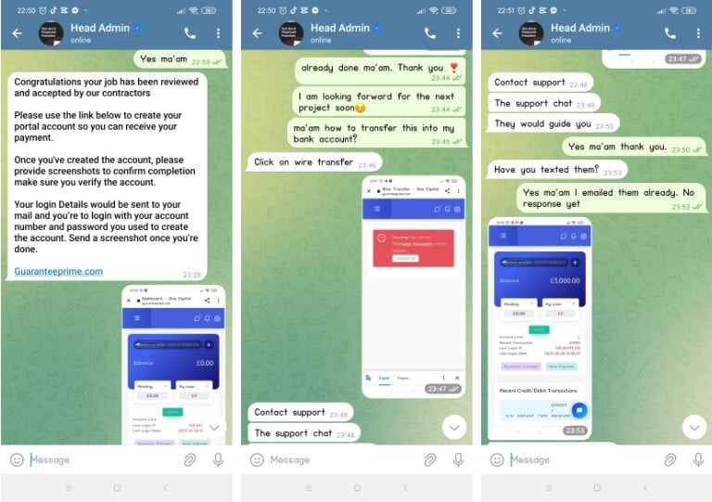
Real-life scenarios

Slide 6



Real-life scenarios

Slide 7
EXISTING WORK
General Threat
Signature-Based Detection
Manual Monitoring
Board Monitoring (Not Scam-Focused)
Alerts and Reports.

Slide 8
EXISTING WORK
Flare's Telegram Monitoring for Cybersecurity
Eternity Project's Ransomware-as-a-Service (RaaS)
Kaspersky's Discovery of a Global Telegram Malicious Campaign
Machine Learning for Network Defense with Telegram Integration

Slide 9
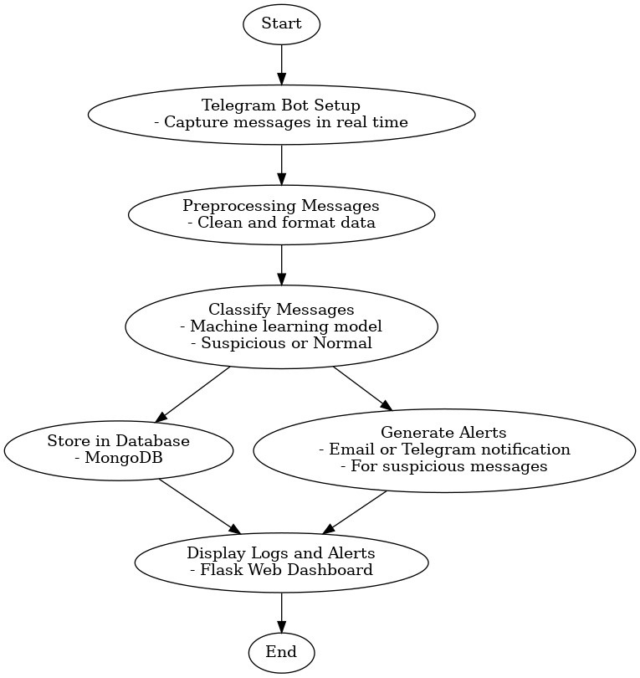
WORK FLOW

Slide 10
PROPOSED WORK
1.Specific Focus on Financial Scams
Existing tools focus on general threats like malware or illegal trading.
Your project specifically targets scams like fake money offers, phishing for bank details, and fake government alerts.
2.Machine Learning for Better Detection
Most systems rely on fixed rules, which miss new or modified scams.
Your project uses machine learning to adapt and detect evolving scam patterns.

Slide 11
PROPOSED WORK
3.Real-Time Alerts
Many solutions provide delayed reports.
Your project detects scams in real time and sends immediate alerts to reduce response time.
4.Customizable and Open for Everyone
Current tools are often proprietary and not widely accessible.
Your project is open-source and can be easily customized by individuals or organizations.

Slide 12
References
Alansari, M.M.H., Aljazzaf, Z.M. and Sarfraz, M. (2019). On Cyber Crimes and Cyber Security. Developments in Information Security and Cybernetic Wars, pp.1–41. doi:https://doi.org/10.4018/978-1-5225-8304-2.ch001.
Kashyap, S. (2017). Prevention of Cyber Crimes in India A Comparative Study. Inflibnet.ac.in. [online] doi:http://hdl.handle.net/10603/379851.
Anuraj Singh (2007), Volume 05, Issue 06, PP. 11273- 11279‌
‌
‌

Slide 13
Thank You

